Slide 1
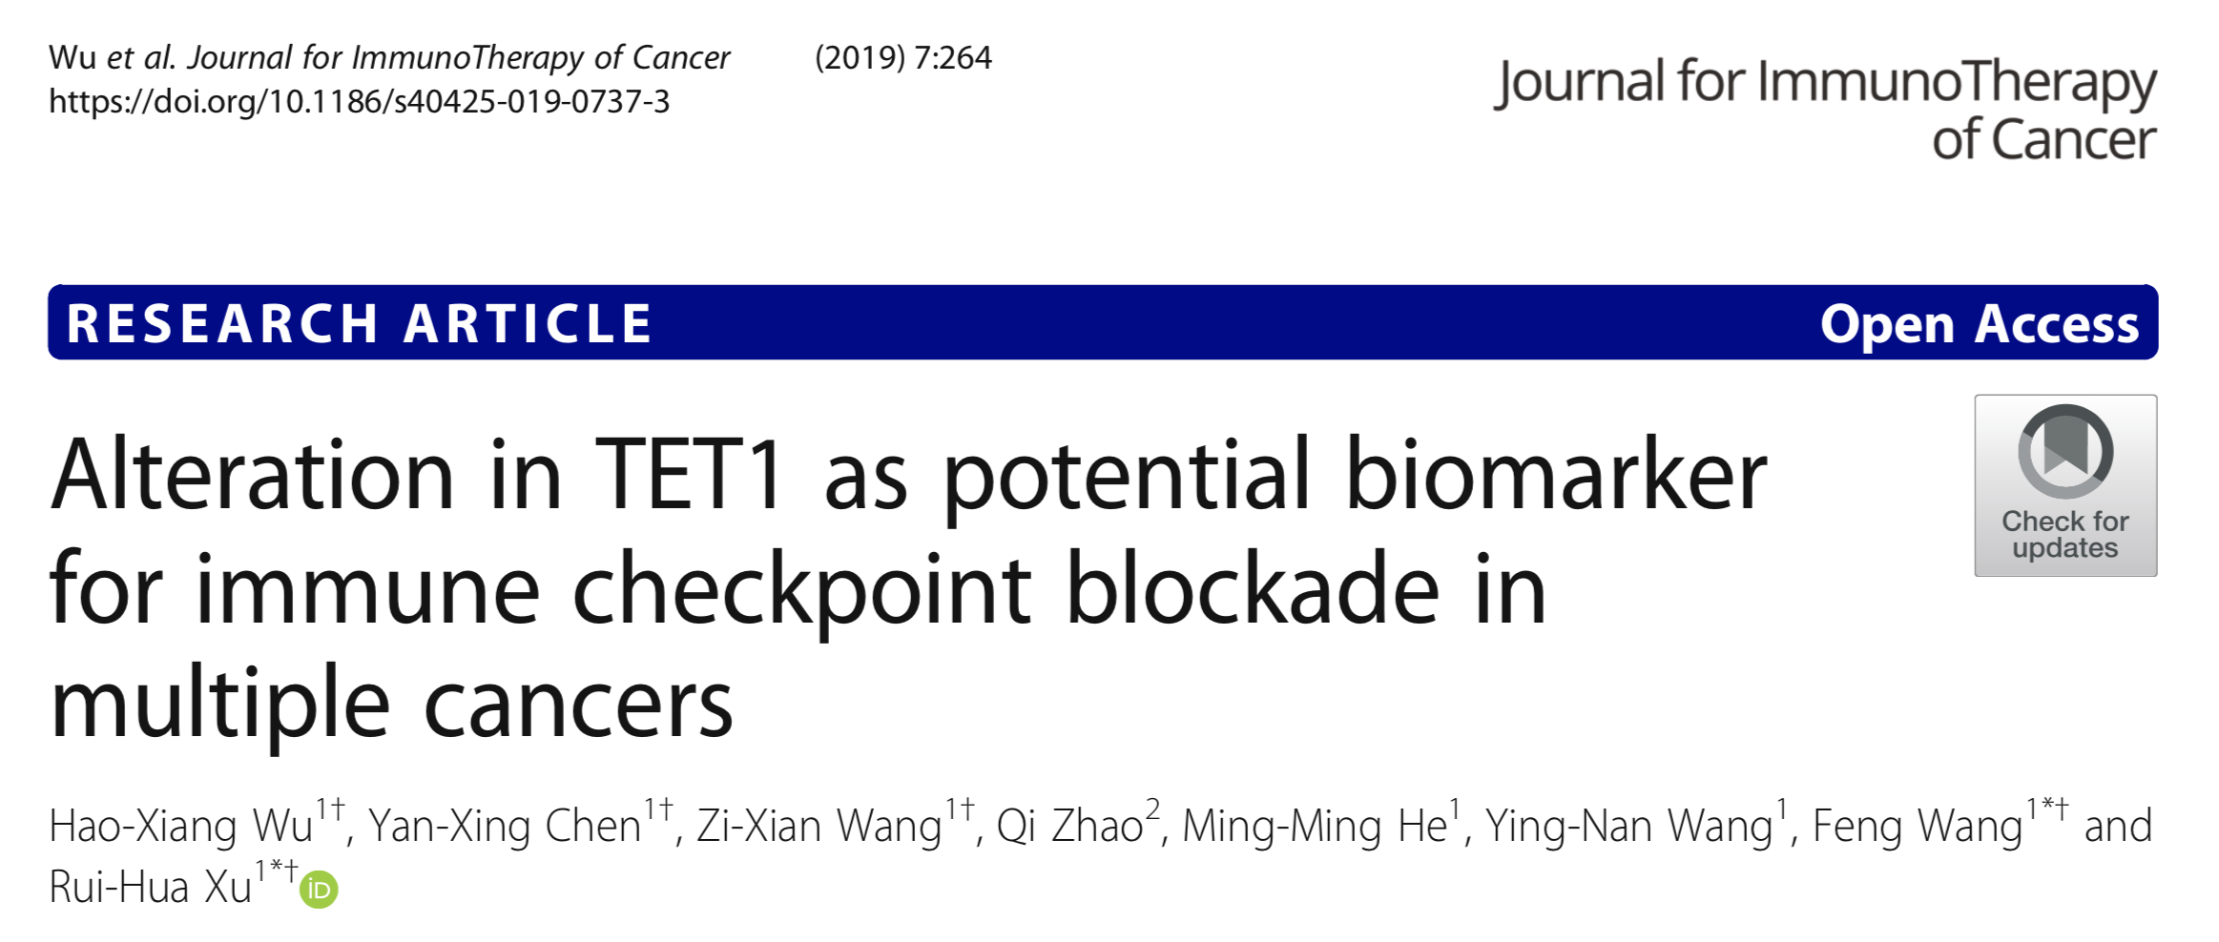

Slide 2
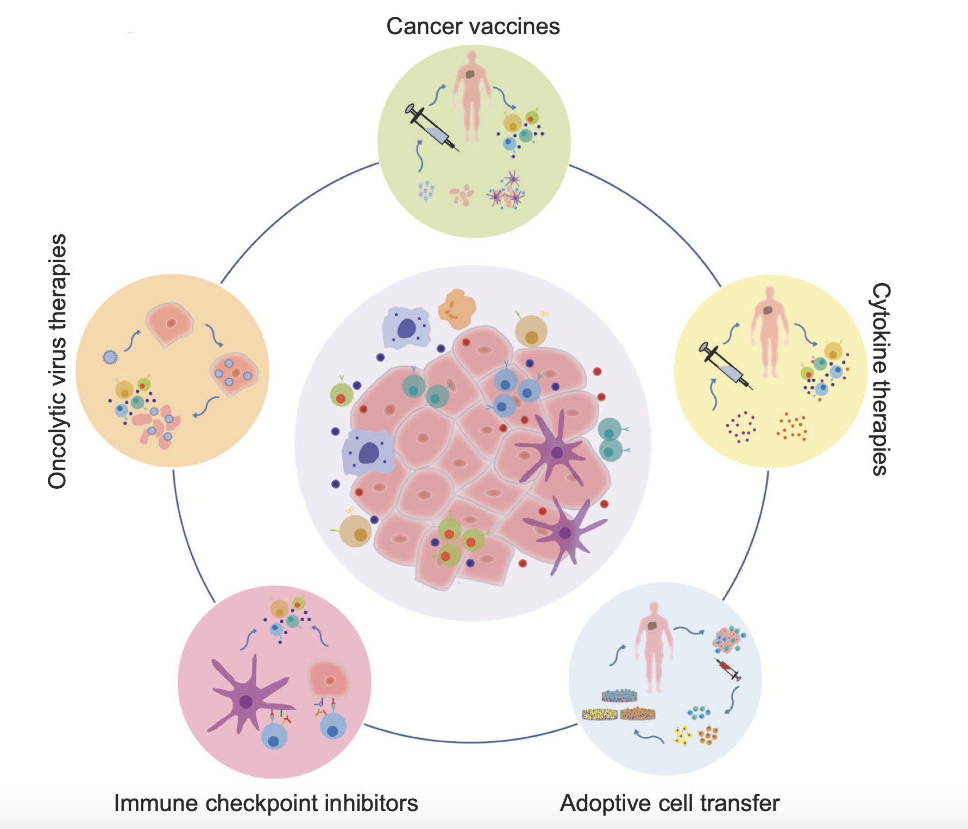



The major categories of immunotherapy
Zemin Zhang et al., 2020, Nature

Slide 3
Immune checkpoint blockade biomarker
Target ： PD-1(T cell); CTLA-4(T cell)和PD-L1(tumor cell)
PD-L1 expression
High microsatellite instability (MSI-H)
Tumor mutational burden (TMB)
T cell-inflamed gene expression profile (GEP)

Slide 4
theme
TET1 ： DNA demethylase
DNA methylation and anti-tumor immunity has increasing evidences, association of genomic alterations in DNA methylation-related genes and ICI response are lacking
DNA methylation signature was recently reported to be associated with the efficacy of anti-PD-1 treatment in non-small-cell lung cancer (NSCLC)

Slide 5
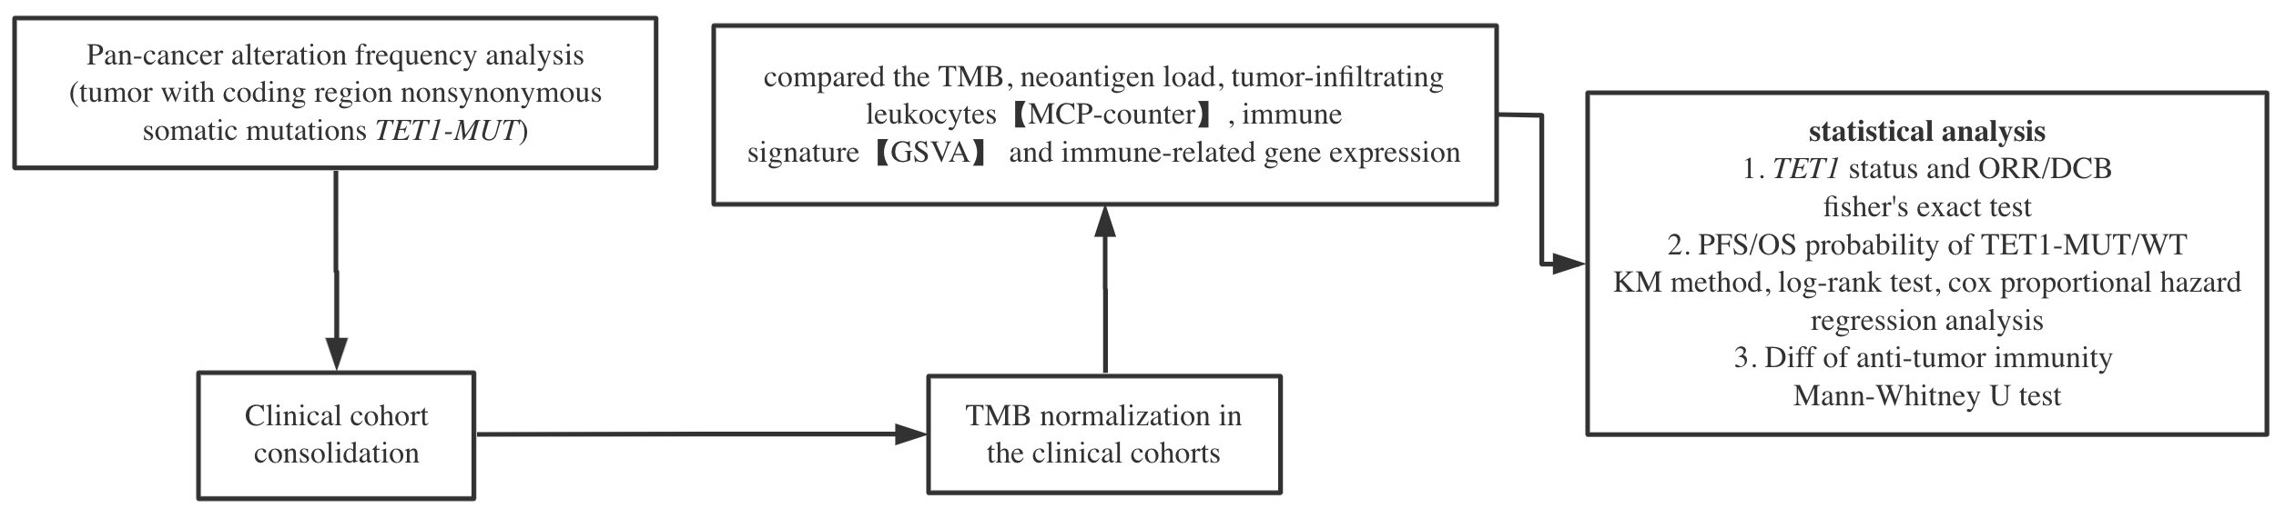
Analysis methods

Slide 6
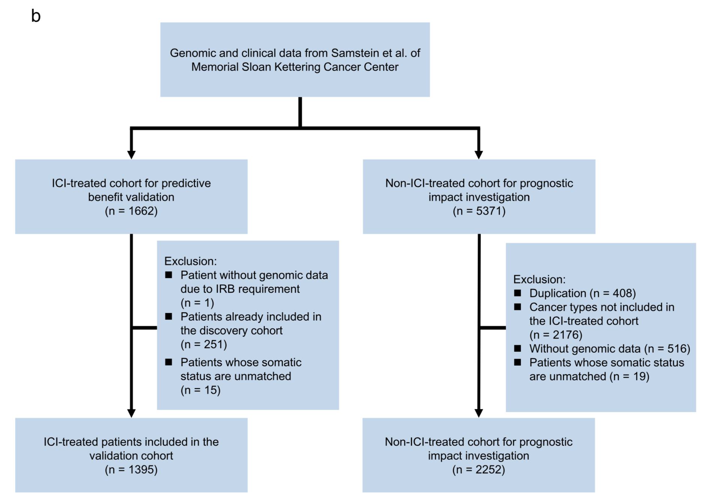
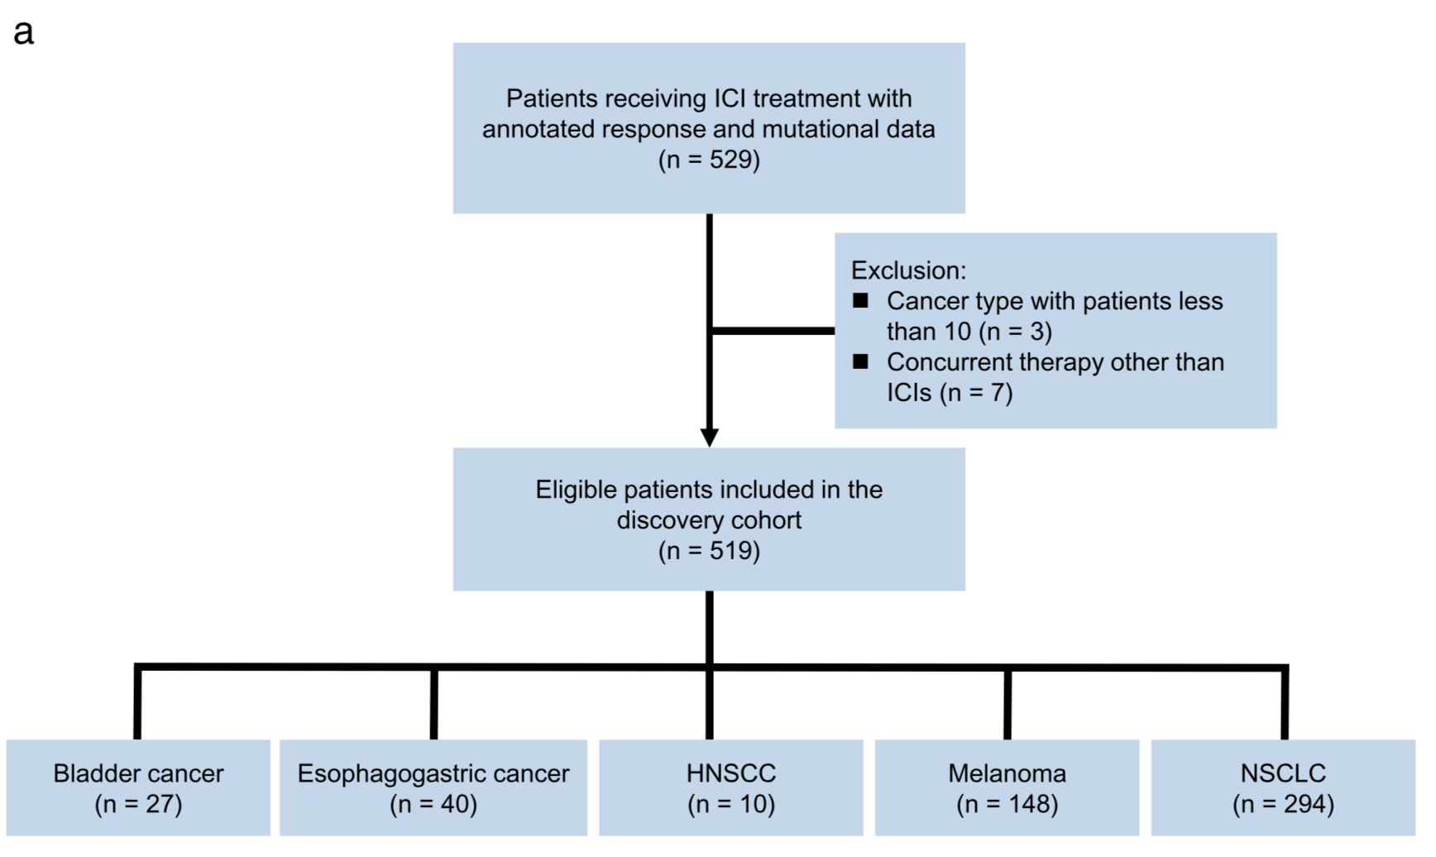
Clinical cohort consolidation
Validation cohort
Discovery cohort
n = 280 panel sequencing
n = 249 WES sequencing

Slide 7
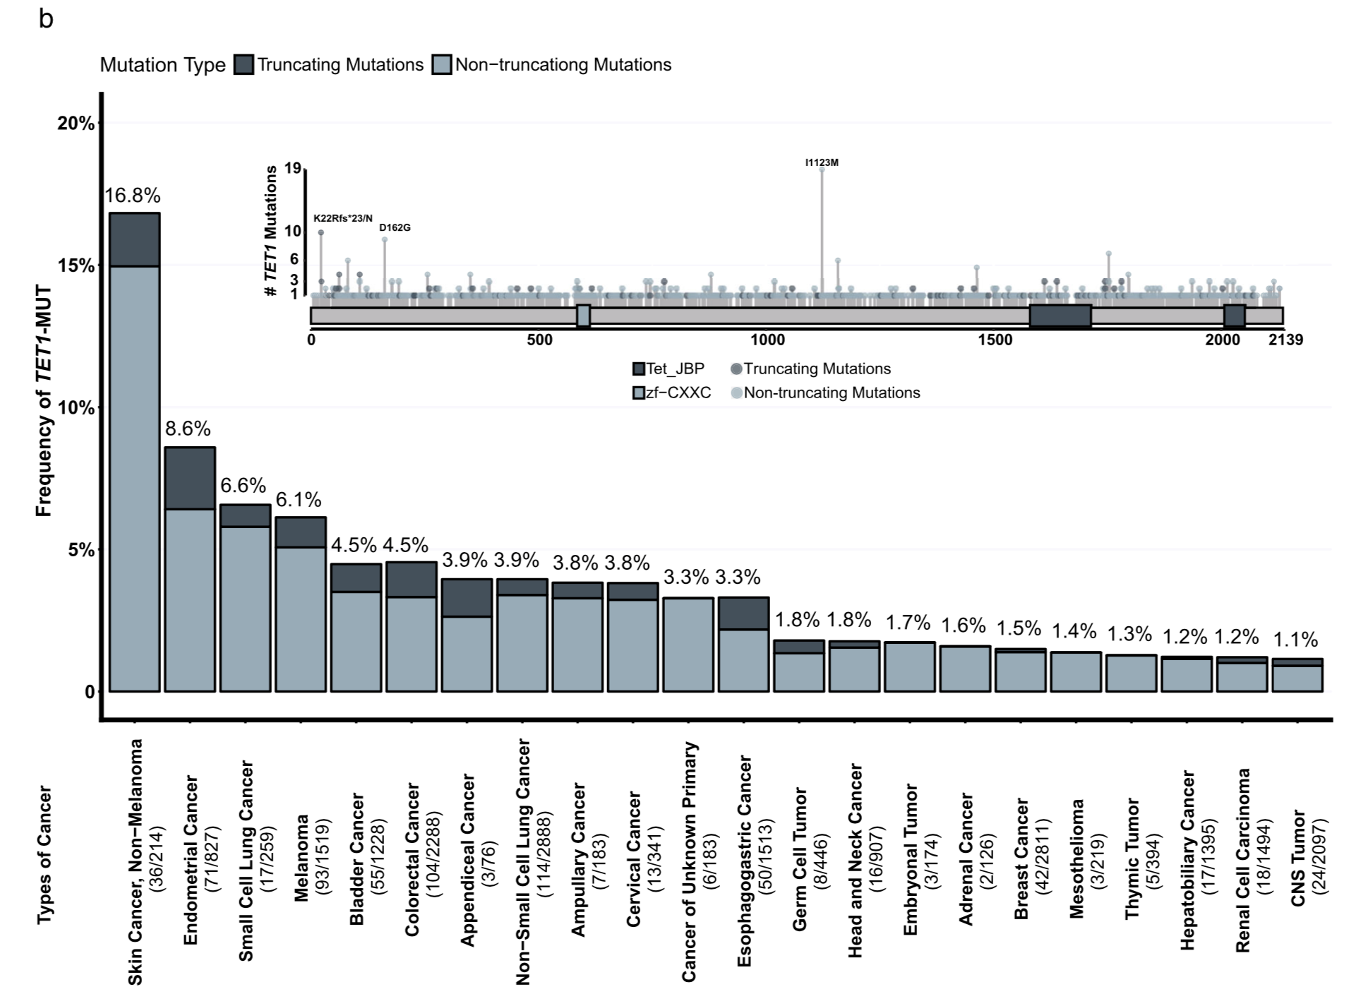
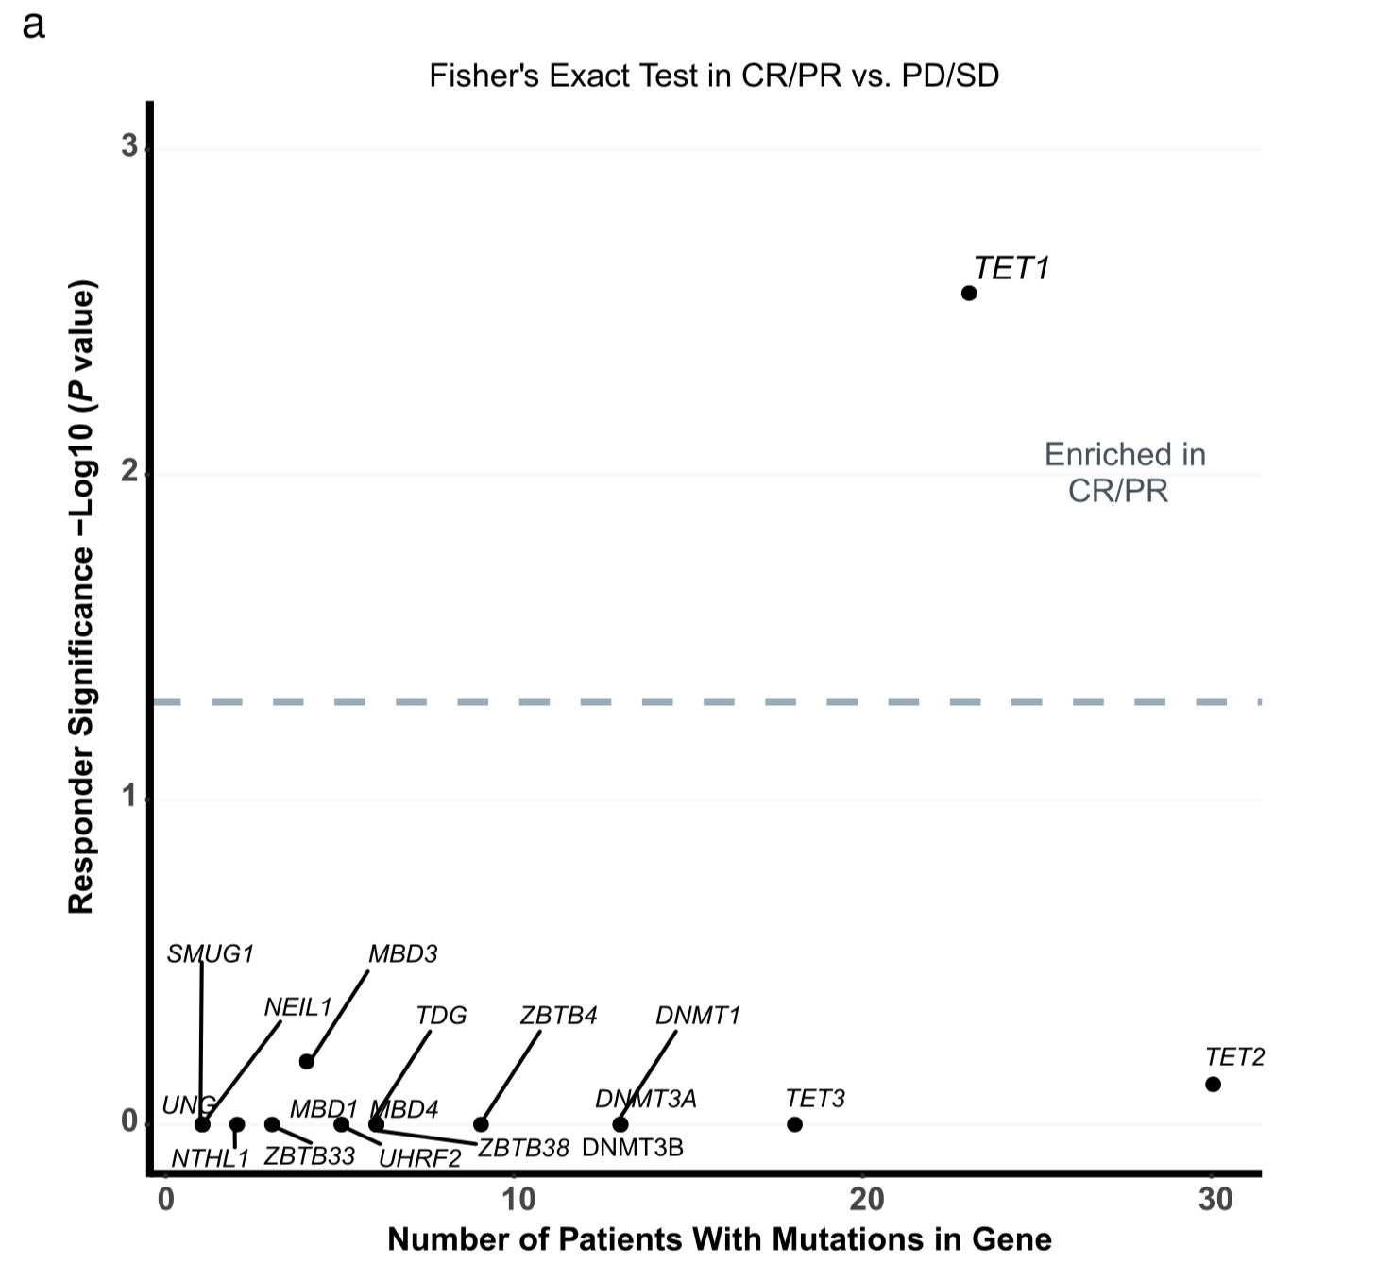
TET1 mutation

Slide 8
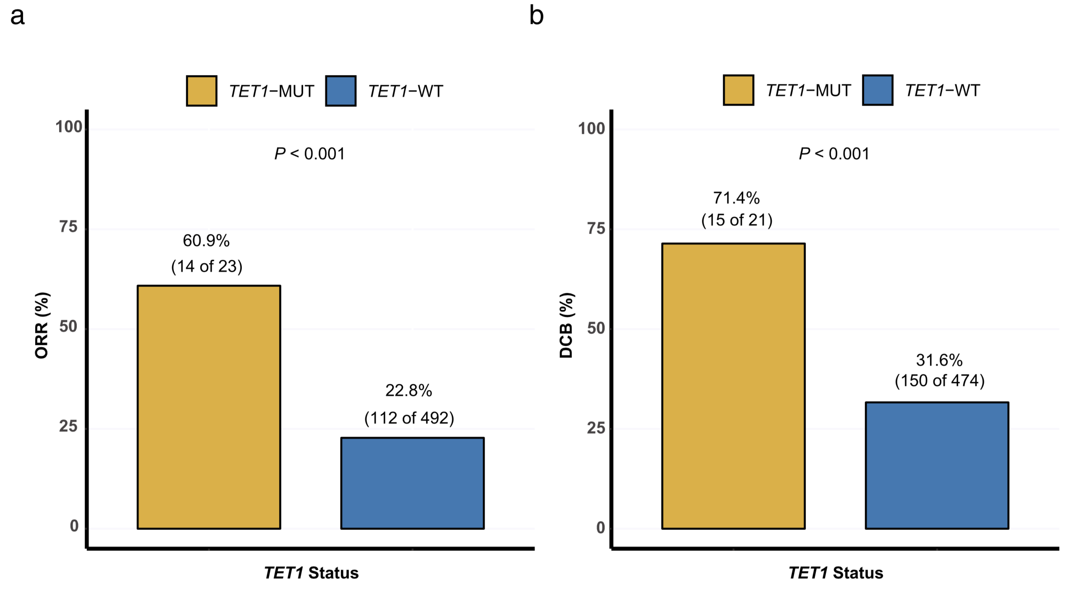
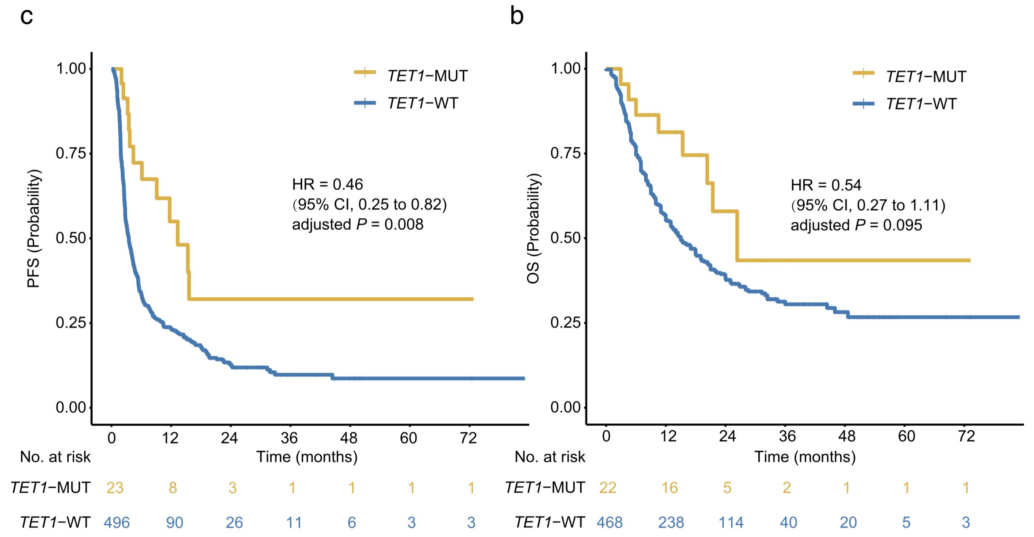
Association of TET1 status and clinical outcomes in the discovery cohort

Slide 9
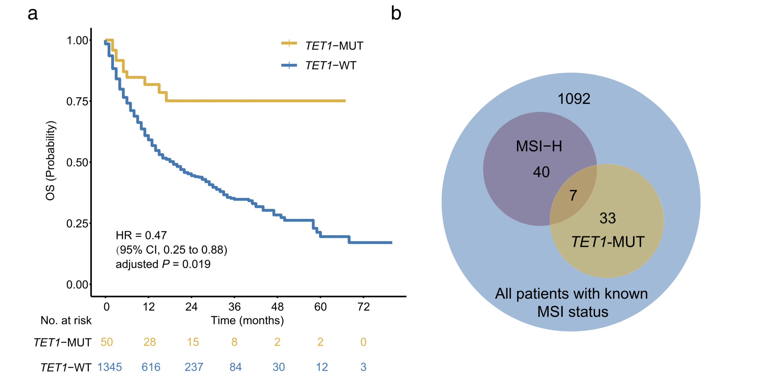
Validation of the predictive function of TET1-MUT

Slide 10
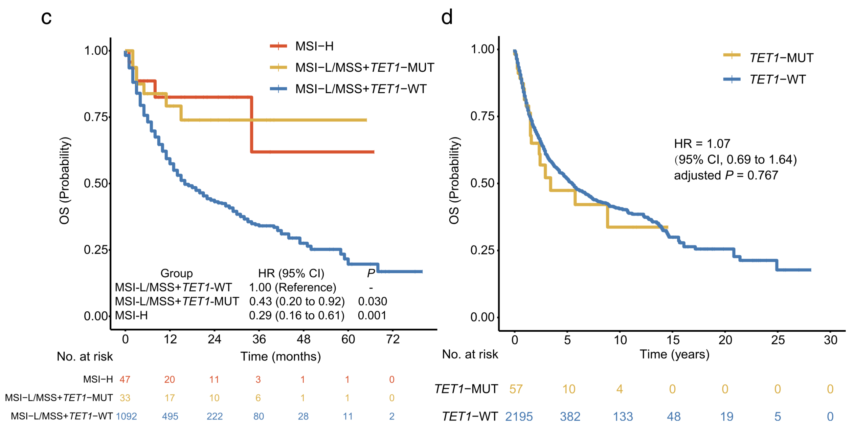
Validation of the predictive function of TET1-MUT
OS was significantly longer than that of TET1-WT patients nearly equal to that of MSI-H patients

Slide 11
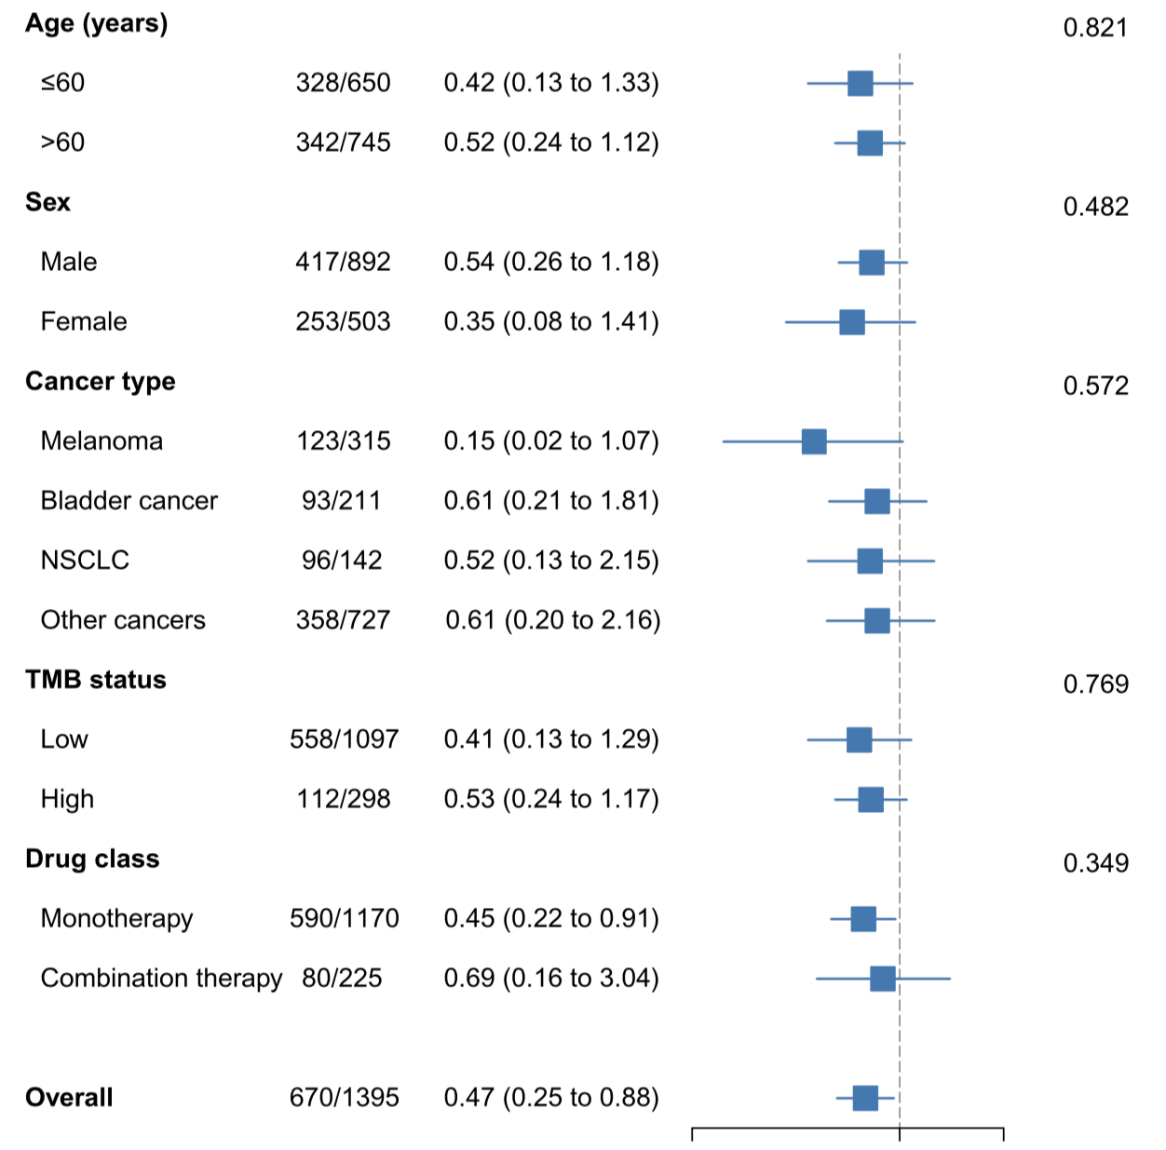
Stratification analysis in subgroups

Slide 12
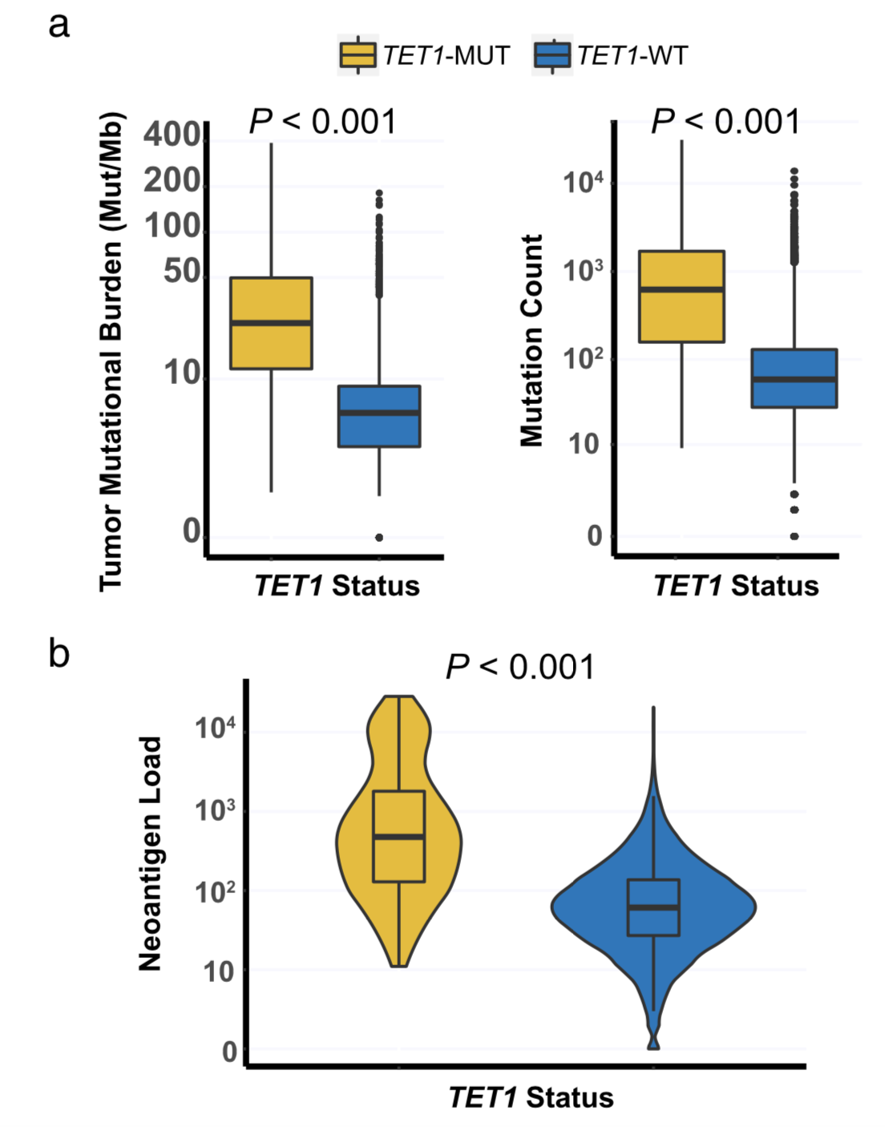
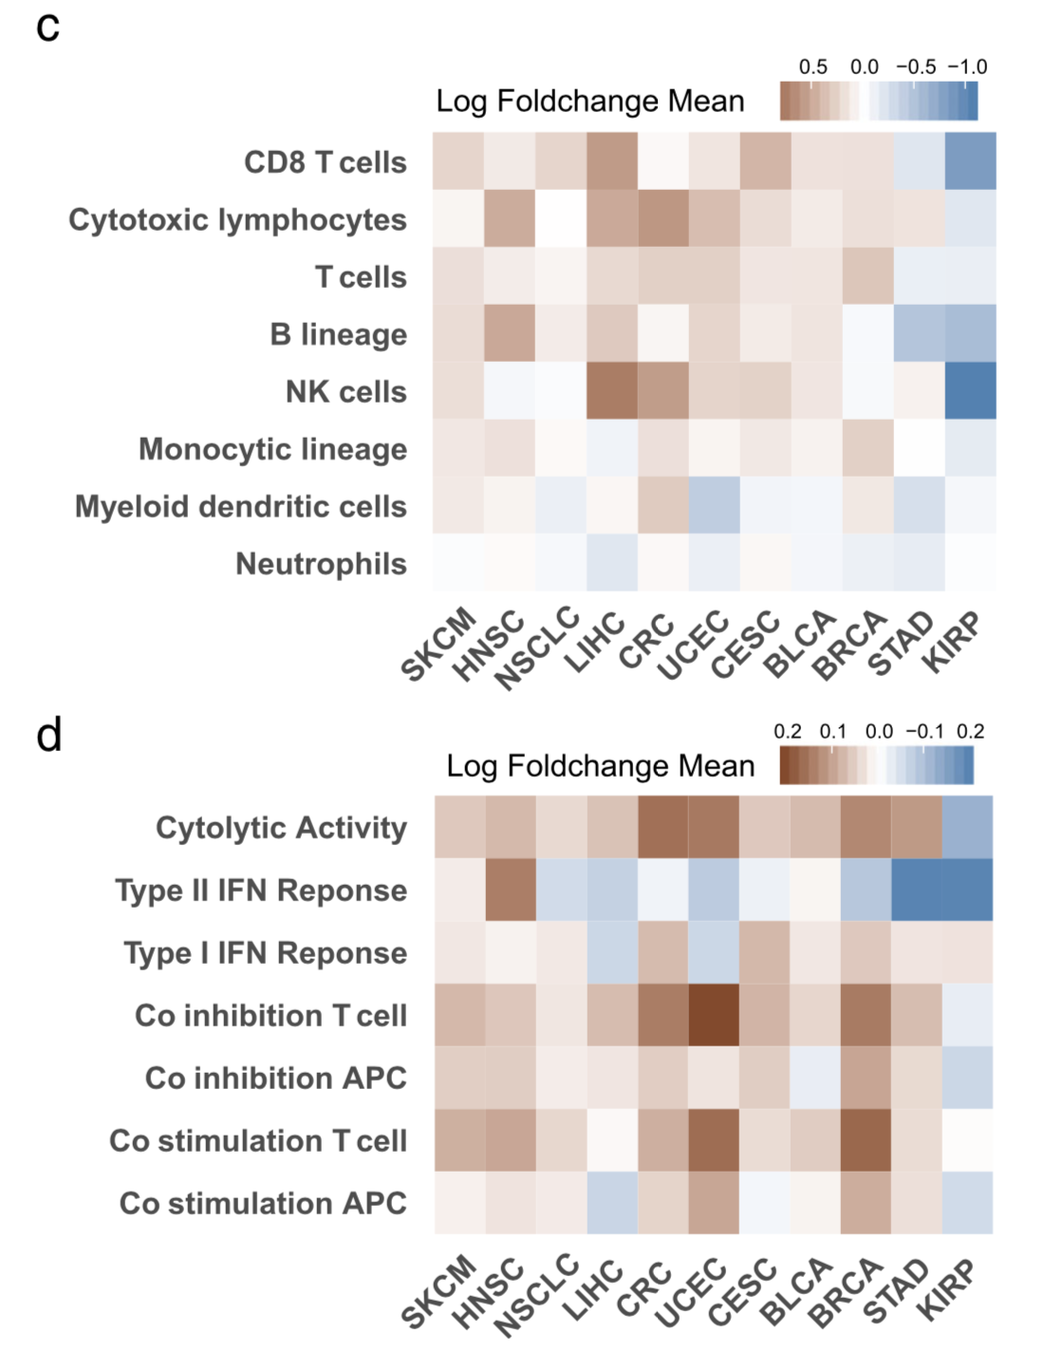
TET1-MUT was associated with enhanced tumor immunogenicity and activated anti-tumor immunity

Slide 13
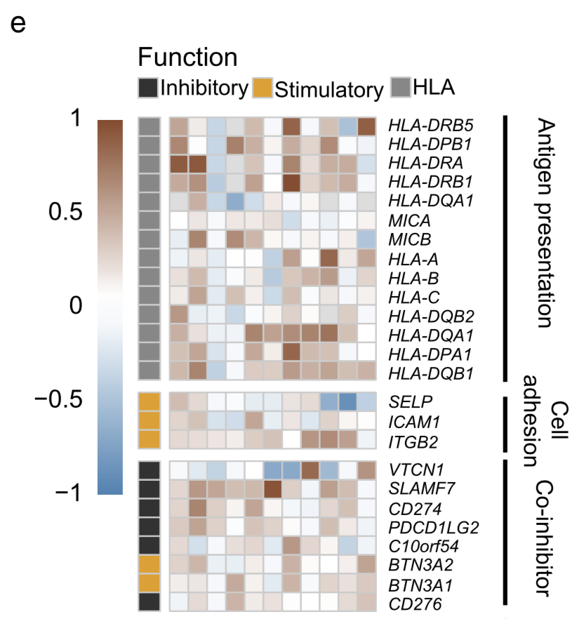
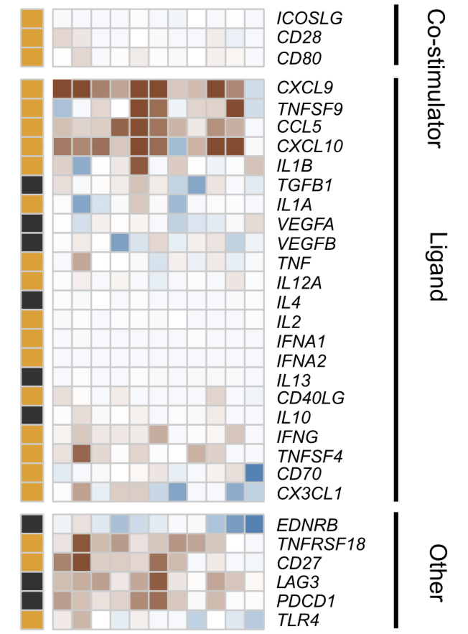
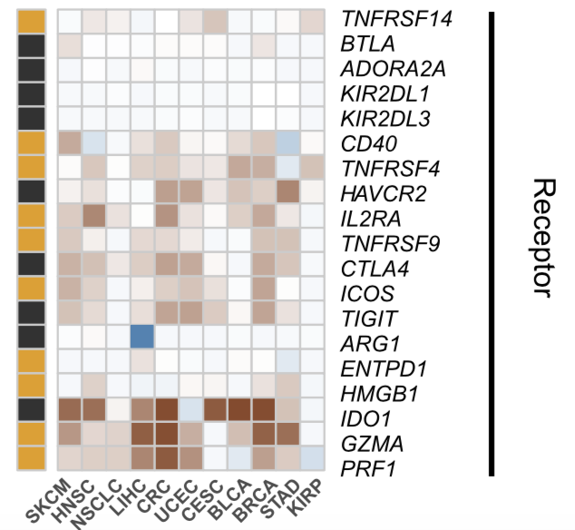
Heatmap depicting the mean differences in immune-related gene mRNA expressions between TET1-MUT and TET1-WT tumors across different cancer types

